Slide 1
Providence Hills Capital Improvement Planning
2022 Planning

Slide 2
What to Expect
Warning: Information overload possible!
All aspects of Community Association assets are being reviewed, but long term roadmap creation
Data driven approach to lead to transparency in decisions
Quotes were asked for high end: Quote all, and we can negotiate
Your feedback and input is crucial

Slide 3
Guiding Principles
2020 Project List and resident input will be our primary intake methods
All ideas submitted will be researched for consideration
One quote will be obtained for each idea; at least three quotes are recommended if we are to move forward with the idea
Based on need, each idea will receive one of three dispositions:
Plan Now
Add to/Update on Project List
Defer

Slide 4
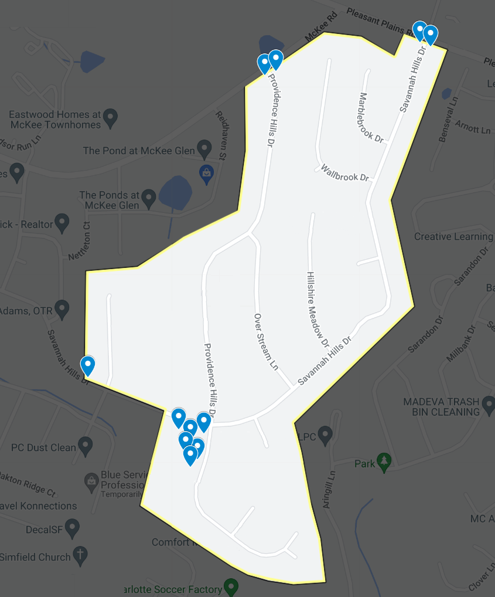

Slide 5
Entrances

Slide 6
Electrical (#5)
There are issues with regular lighting and holiday lighting at the entrances
Proper assessment and resolution may cost: $1,800+ (includes all 3 entrances)

Slide 7
Pressure Wash (#7)
Our entrances do not appear to be well maintained
Pressure washing may cost: $2,200+ (includes all 3 entrances, clubhouse exterior, walkways around clubhouse)

Slide 8
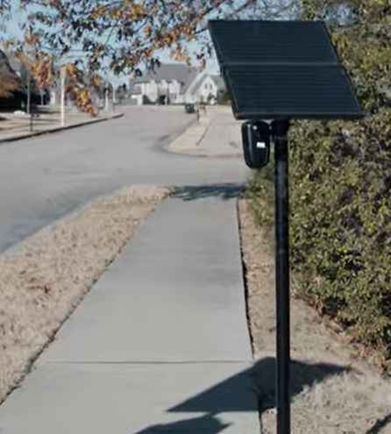
License Plate Reader (#16)
No ability to help with crime in the area
License Plate Reader system:
Restricted access to data for up to 30 days
Ability to send data to: Matthews, Indian Trail, Charlotte, Stallings police when crimes or local alerts
Data provided to National Center for Missing & Exploited Children and National Crime Information Center
Solar-powered and LTE enabled, no maintenance
Install may cost: $350 install and $2,400 annually per reader ($1,050 and $7,200 annually if all 3 entrances)

Slide 9
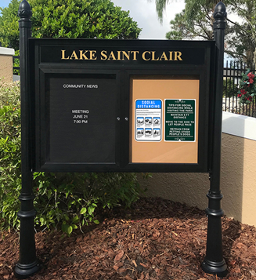
Message Board (#30)
Replace our message boards with newer and easier maintenance boards.
Currently awaiting quote.
Includes: All three entrances, clubhouse lawn, pool house

Slide 10
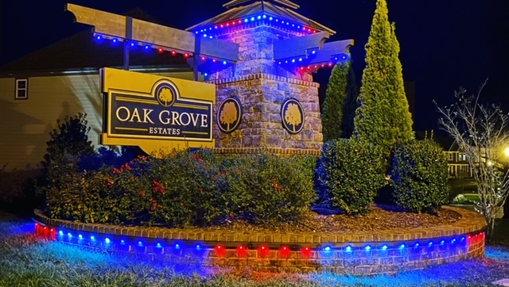
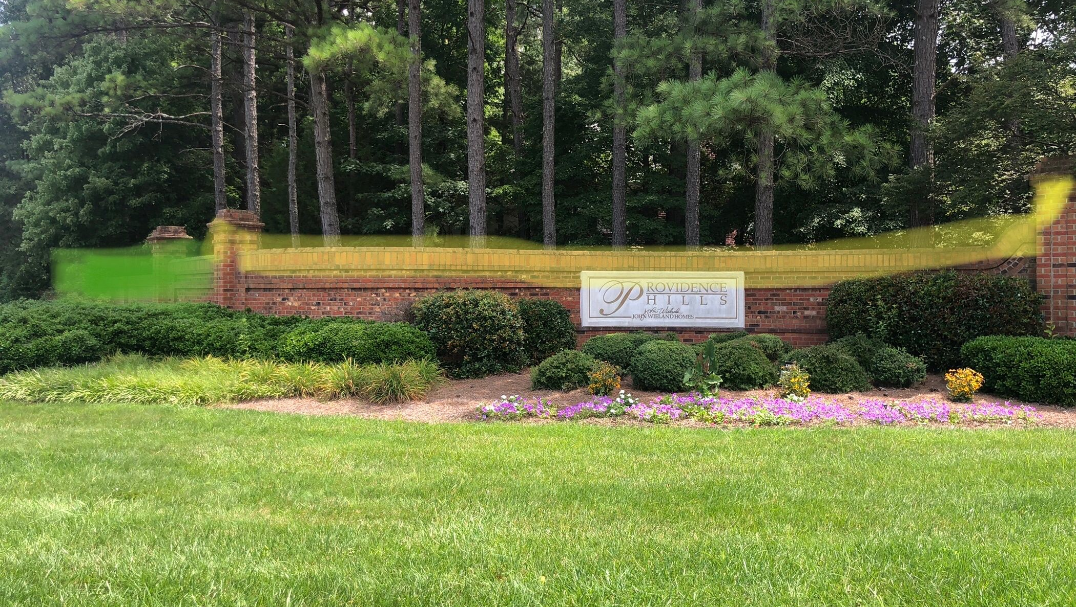
Permanent Lighting (#31)
Install permanent decorative lighting, to reduce maintenance cost and time required – and to have the ability to light at any time
This may cost: $13,000+ (includes all 3 entrances)

Slide 11
Landscaping (#34)
Our neighborhood entrances and clubhouse can use some more color and popular shrubs, as well as a redesign to avoid blocking the signs and lights
This may cost: $29,000+ (includes all three entrances and clubhouse)

Slide 12
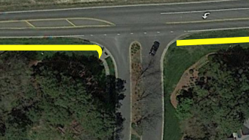
Sidewalk (#17)
Extend the sidewalk on McKee Road across our neighborhood property
This may cost: $13,800+
Note 1: NC DOT has the McKee Road extension project in FY2025 – we can see if this can be included
Note II: Desire recently heard for Savannah Hills, Pleasant Plains as well

Slide 13
Providence Hills Dr. Traffic

Slide 14
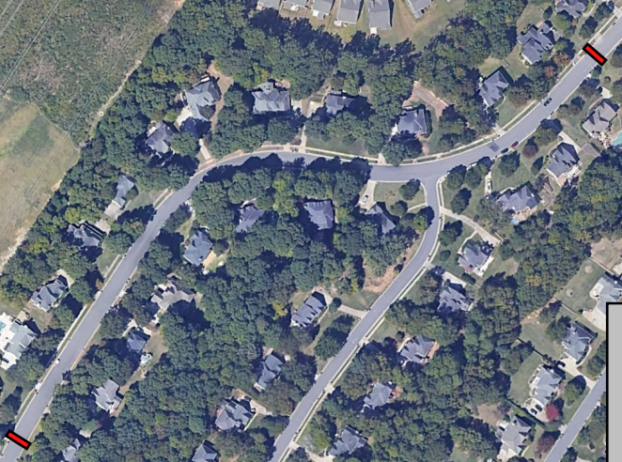
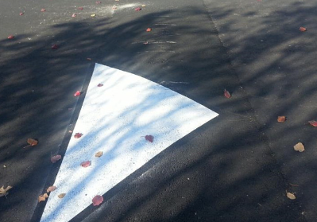
Traffic Calming Measures (#15)
Speeding along Providence Hills Drive is a concern
To install two speed bumps, it may cost: $2,200+

Slide 15
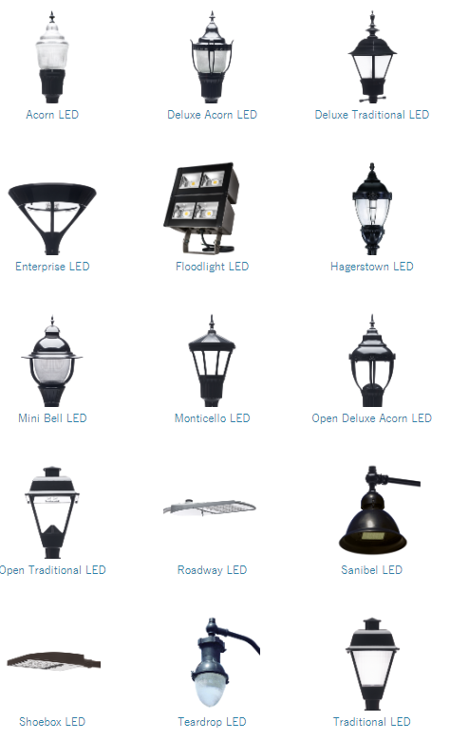
Street Lights (#18)
Lack of lighting along our roads throughout the neighborhood is a safety concern
Lighting costs are typically paid by the utility/municipality, but there are costs if we do not go with the standard light pole
Costs are TBD based on selection, but may start at $1,200/light pole
Note 1: Different processes between Charlotte/Mecklenburg and Indian Trail/Union
Note II: Some of our streets are already prewired for this

Slide 16
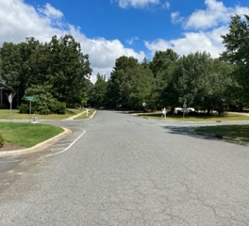
Four-Way Stop (#19)
Convert Providence Hills & Savannah Hills intersection to be a four-way stop for safety concerns
NC DOT has assigned an engineer to study this intersection and will provide us with more information

Slide 17
Pet waste elimination system
Install pet waste systems to provide waste bags and place to dispose
Systems cost about $250 / station. Four stations, clubhouse plus three entrances would cost about $1,000 plus an effort to install. We have inquired with our landscaper if they would be able to empty these on a routine basis.

Slide 18
Neighborhood Amenities

Slide 19
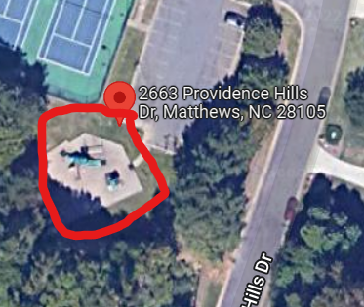
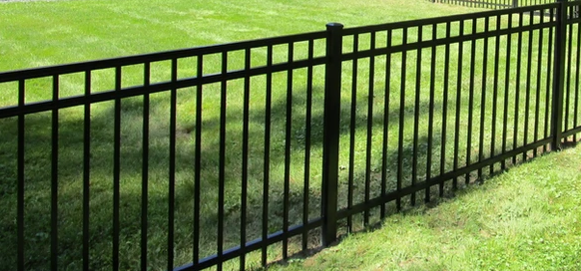
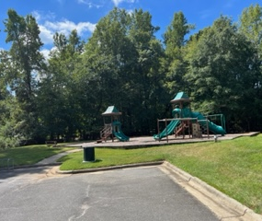
Playground (#6)
Fence in the playground and the surrounding grass area
This may cost: $11,000+

Slide 20
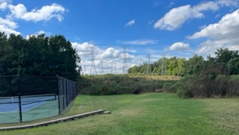
Fire Pit (#13)
Convert the grassy area next to the tennis courts into a firepit area
The first quote is for fencing the area, and may cost: $7,400+
Subsequent quotes may be needed for landscaping, hardscaping, furniture, electrical, water

Slide 21
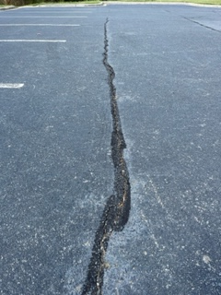
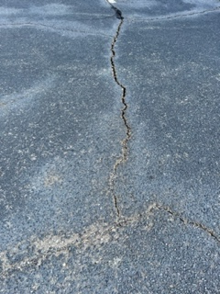
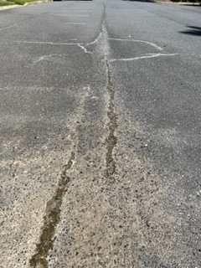
Paving (#8)
Have our parking lots repaved and lined, and include lines for basketball
A full mill and pave may cost $53,000 (incl. both lots)
A striping incl. basketball may cost: $3,000+ (incl. both lots)
Note: Cracks can be resealed again, asphalt company mentioned this parking lot may have additional life as is

Slide 22
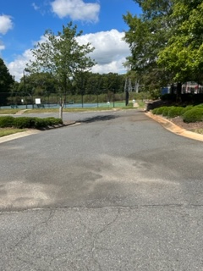
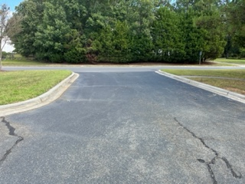
Parking Lot Gates (#14)
Install gates on our parking lots
Installing 22’ wide Double Drive Galvanized Barriers may cost: $3,000 (includes both lots)
Note: Will need to determine rules and regulations

Slide 23
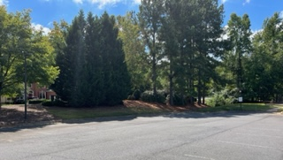
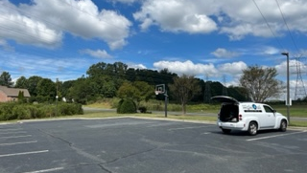
Parking Lot Lighting (#28)
Install better lighting at our neighborhood parking lots
Installing 6 new LED lights and definite existing light fixtures may cost: $24,000+
Note: Will inquire with municipalities if this can be included with street light effort

Slide 24
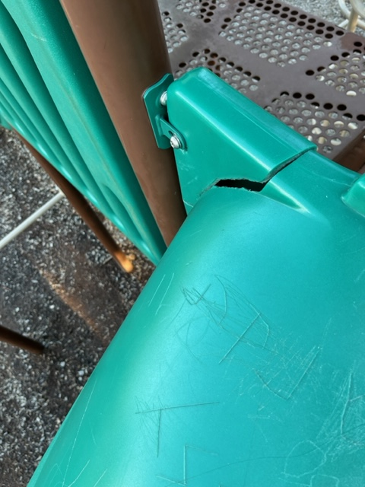
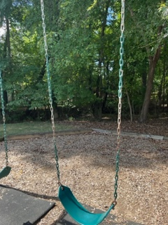
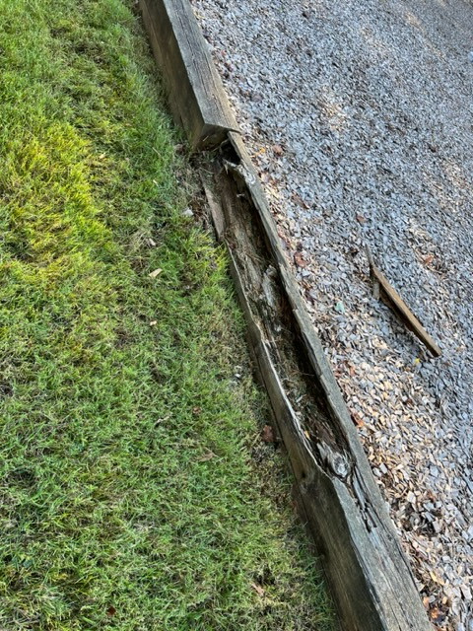
Playground Equipment Replacement (#23)
Replace the current playground equipment with new equipment
We are still working with a vendor to obtain a quote

Slide 25
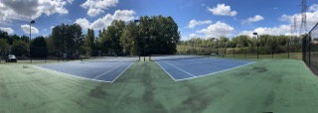
Tennis Court Lighting (#27)
Replacing the tennis court lighting is on the 2020 project list
We are still working with a vendor to obtain a quote

Slide 26
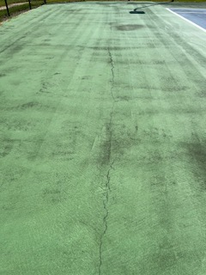
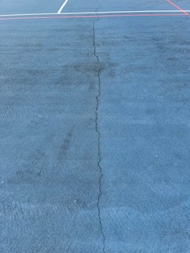
Tennis Court Resurfacing (#26)
Replacing the tennis court lighting is on the 2020 project list
We are still working with a vendor to obtain a quote

Slide 27
Clubhouse Interior

Slide 28
Security (#1) / Security Cameras (#32)
Upgrade our security system to a current system – and to add the ability to have security cameras
Installing a new system may cost $375+ and $49.99+/month
Includes door sensors, motion sensor, glass break sensor
Note I: Designated recipients can receive text/email alerts when alarm is triggered
Note II: Upgrade is needed if we pursue key fob system

Slide 29
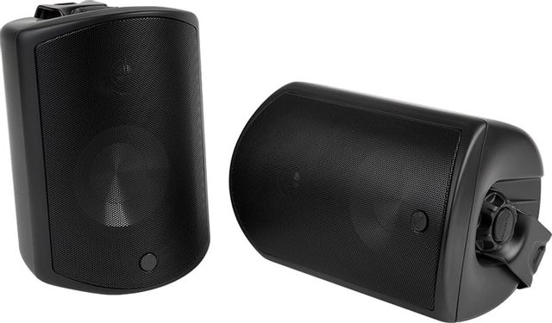
Audio Video (#2)
Modernize the TV and audio system, to allow for Bluetooth use, internet use, and compatibility / synchronization between pool and clubhouse
To install a system like this may cost: $8,400+
Note: Will need to determine rules and regulations
We have also heard about the desire to purchase a HDTV antenna for local channel accessibility may cost: $30+

Slide 30
Electrical (#5)
Upon inspection, multiple electrical safety and functional issues have been found within our clubhouse and pool house
Repairing these may cost: $6,700+

Slide 31
Windows (#4)
Our windows are older in age and are showing end-of-life signs
To replace the 25 windows and 4 French doors may cost: $67,000+

Slide 32
Internet (#9)
Add internet to our clubhouse, and Wi-Fi to the greater clubhouse and pool area
To obtain phone and internet may cost: $109+/month
Copper line phone required for pool; currently paying about $80/month
To install a Wireless Access Point to create the Wi-Fi network may cost: $800+
Note: Will need to determine rules and regulations

Slide 33
Reservation System (#10)
Have an online clubhouse reservation system.
There are multiple tools available, but we will need to determine who and how we will manage the clubhouse for a solution to be feasible
Note: Will need to determine rules and regulations

Slide 34
Fire Suppression (#12)
Determine if we need to have a fire suppression system
Upon analysis, we do not need a system in place.
To install a monitoring system may cost: $600+/year

Slide 35
Painting (#21)
Repaint the interior and exterior of the pool and clubhouses, and pergola to be a more modern appearance
Total cost of the project may be: $19,000+
Note: Drywall and siding repairs necessary prior to painting are not included in this quote.
Note II: Pressure washing of the buildings being repainted will be performed by painting company

Slide 36
Furniture Replacement (#22)
Replacing the clubhouse furniture is on the 2020 project list
A quote has not been obtained; waiting on other clubhouse decisions to be made first

Slide 37
HVAC (#25)
Our HVAC system was last replaced in 2019 and is in good shape
Outside of regular maintenance, no work is needed until 2034. A quote will be received in the future.

Slide 38
Clubhouse Exterior

Slide 39
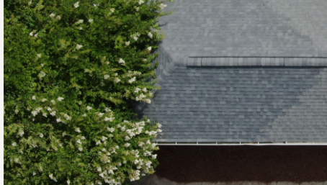
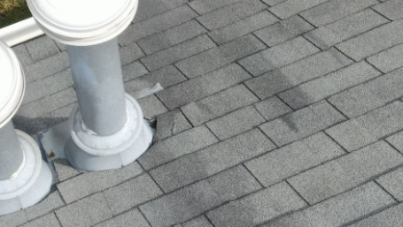
Roofing (#3)
Our roofs were last replaced in 2012 and are generally in good shape.
There is hail damage visible. It is recommended we file an insurance claim and have the repairs made where there is damage
The cost may be: Insurance Policy Deductible
There is a recommendation that we cut back the crepe myrtle trees overhanging the pool house

Slide 40
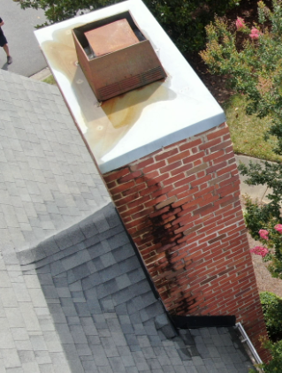
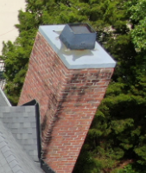
Chimneys
Our chimneys have had a history of drainage/leak issues. Water damage is visible on the chimneys.
We have not yet obtained a quote for inspection, draining, and structural repairs

Slide 41
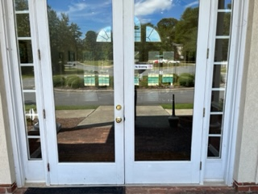
Key Fob System (#11)
Replace our current access to clubhouse and pool with a fob or card system
Costs may include: $8,000+ for install (pool and clubhouse), $45+/month, plus $5/replacement card
Note: Will need to determine rules and regulations

Slide 42
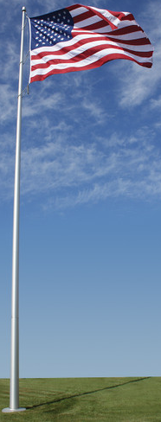
Lighted Flagpole (#29)
A lighted flagpole was on the 2020 project list.
Costs to order and install may be: $1,700+

Slide 43
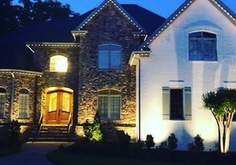
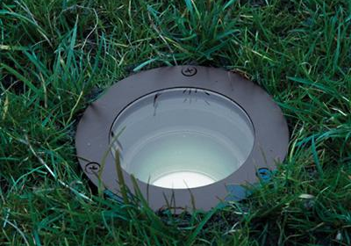
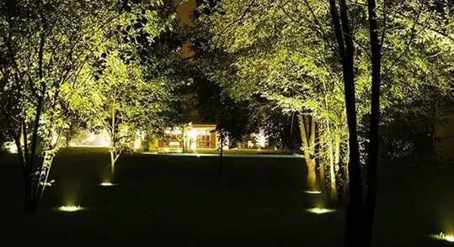
Permanent Lighting (#31)
Install mutliple types of permanent lighting at the clubhouse:
Tree illumination lighting
Sidewalk lighting
Trim lighting
Total costs may be: $25,000+

Slide 44
Pool & Pool house

Slide 45
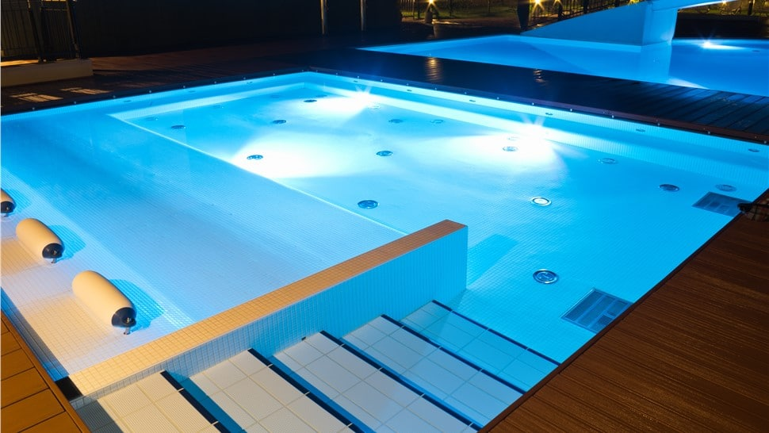
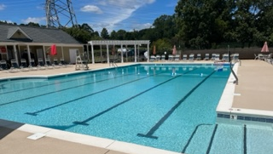
In Pool Lighting
Install in pool lighting
A quote of $36,100 was received in winter 2021
Note: Will need to determine rules and regulations

Slide 46
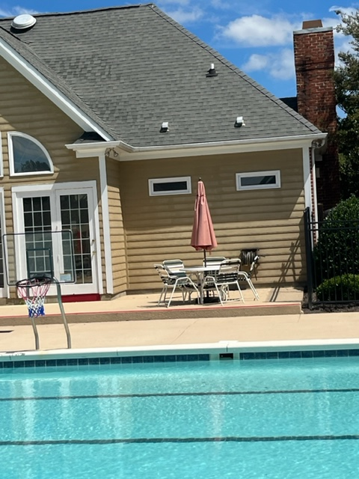
Clock
Ability to have a large LED solar/battery clock at the pool for the lifeguards
Quote is still being obtained for clock and housing

Slide 47
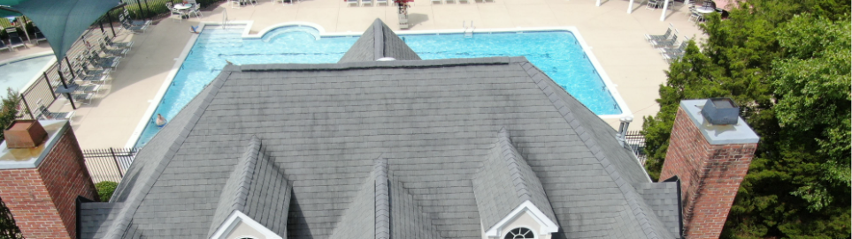
Pool Shade Replacement (#24)
Replacing the pool shade is on the 2020 project list
We are still working with a vendor to obtain a quote

Slide 48
Recommendations / Action Items

