Slide 1
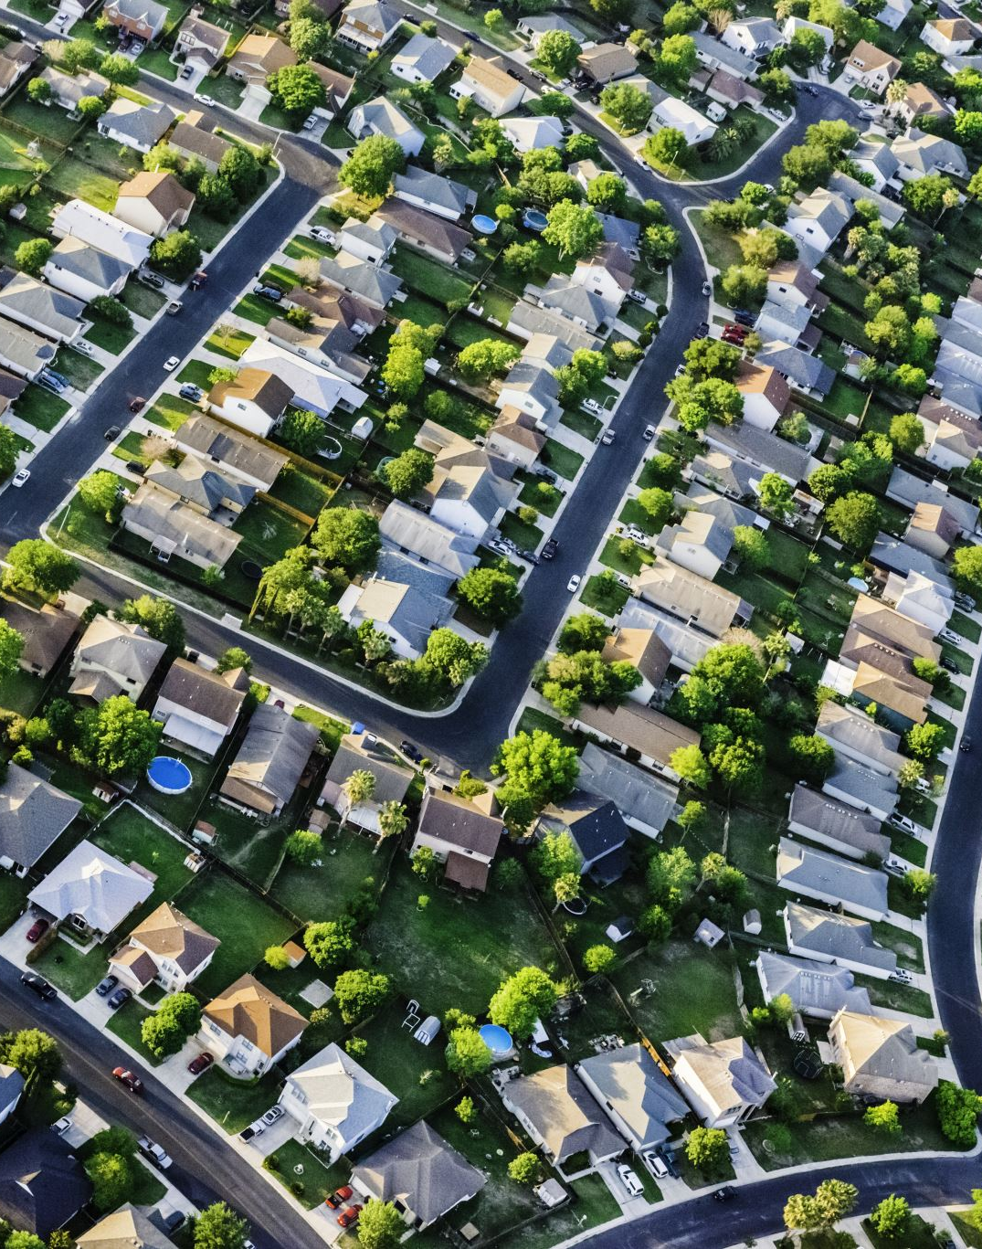
Providence Hills Survey Responses
2022 Survey

Slide 2
Purpose
Collect input from residents to inform programming and planning
Review results, with expectation of list of recommendations for Board

Slide 3
Who Took Survey? Valid Sample Size?
41 homes (15.8%) v. 15% target
Average Years of Ownership: 12.2 (y) v. 13.3 (avg)
Median Years of Ownership: 10 (y) v. 13 (avg)

Slide 4
Assessing the Results
Personas
Emily, Lower 40s, Two Kids (3rd grade, preschool), Been in Neighborhood 4 Years
Keith, Mid 60s, No Kids at Home, Been in Neighborhood 22 Years
Categorization
Overall
Children v. No Children/At Home
Below v. Above Median Ownership Age

Slide 5
Most Appreciated Features

Slide 6
Most Need for Improvement

Slide 7
Top Priority Areas
Grouping | Top | #2 | #3 | #4 | #5
Overall | Common Area Improvements | Common Area Maintenance | Homeowner Upkeep | Neighborhood Safety | Traffic
Children at Home | Common Area Improvements | Family Social Activities (Tie – 2) | Neighborhood Safety (Tie - 2) | Homeowner Upkeep (Tie – 4) | Neighborhood Communications (Tie – 4)
No Children at Home | Homeowner Upkeep | Traffic | Rental Properties | Common Area Maintenance (Tie – 4) | Common Area Improvements (Tie – 4)
Ownership < Median | Common Area Improvements | Neighborhood Safety (Tie – 2) | Common Area Maintenance (Tie – 2) | Family Social Activites (Tie – 4) | Homeowner Upkeep (Tie – 4)
Ownership > Median | Common Area Improvements (Tie – 1) | Homeowner Upkeep (Tie – 1) | Traffic (Tie – 1) | Common Area Maintenance | Covenants Violations

Slide 8
Events

Slide 9
Community Event Attendance
Grouping | Easter Petting Zoo/Egg Hunt | Neighborhood Yard Sale | Pool Opening Party | Monthly Happy Hours | Pool Closing Party | Halloween Parade | Holiday Party / Luminaries
Overall | 34% | 30% | 66% | 61% | 52% | 45% | 80%
Children at Home | 55% | 32% | 73% | 64% | 55% | 59% | 86%
No Children at Home | 16% | 32% | 68% | 68% | 58% | 37% | 84%
Ownership < Median | 45% | 36% | 59% | 73% | 50% | 59% | 91%
Ownership > Median | 24% | 24% | 76% | 52% | 57% | 33% | 71%

Slide 10
Children Age Ranges
Age Range | % of Respondents | Extrapolated # of Households
No Children / No Children Living At Home | 41% | 107
Children In The Future / Under 1 | 7% | 17
Toddler (1-5 years) | 20% | 51
Kids (5-13 years) | 17% | 45
Teenager (13-18 years) | 15% | 39

Slide 11
Event Ideas
4th of July: Parade, Fireworks
Block Party
Book Club
Clubs
Community Golf Outing
Family/Children: BBQ/Picnic/Meet & Greet (During Kids Hours), Get-Togethers/Play Groups for Kids
Movie Night
Organized Halloween Participation
Organized Pickleball Group/League
Panthers Watch Party
Thanksgiving: 5k / Toddle Trot, Something
Trivia Night

Slide 12
Amenities

Slide 13
Use of Pool
Grouping | Never | Sparingly | Monthly | Weekly | Daily
Overall | 15% | 15% | 17% | 51% | 2%
Children at Home | 9% | 9% | 9% | 68% | 5%
No Children at Home | 21% | 21% | 26% | 32% | 0%
Ownership < Median | 5% | 9% | 23% | 59% | 5%
Ownership > Median | 24% | 19% | 10% | 38% | 0%

Slide 14
Use of Tennis/Pickleball
Grouping | Never | Sparingly | Monthly | Weekly | Daily
Overall | 44% | 37% | 17% | 2% | 0%
Children at Home | 41% | 32% | 27% | 0% | 0%
No Children at Home | 47% | 42% | 5% | 5% | 0%
Ownership < Median | 41% | 36% | 23% | 0% | 0%
Ownership > Median | 47% | 37% | 11% | 5% | 0%

Slide 15
Use of Playground
Grouping | Never | Sparingly | Monthly | Weekly | Daily
Overall | 32% | 34% | 24% | 10% | 0%
Children at Home | 14% | 41% | 32% | 14% | 0%
No Children at Home | 53% | 37% | 5% | 5% | 0%
Ownership < Median | 18% | 23% | 45% | 14% | 0%
Ownership > Median | 47% | 47% | 5% | 0% | 0%

Slide 16
Use of Clubhouse
Grouping | Never | Seldom | Sometimes | Often
Overall | 41% | 37% | 20% | 2%
Children at Home | 55% | 23% | 18% | 5%
No Children at Home | 26% | 53% | 21% | 0%
Ownership < Median | 48% | 33% | 14% | 5%
Ownership > Median | 35% | 40% | 25% | 0%

Slide 17
Use of Amenities Comparison
Grouping | Never | Sparingly | Monthly | Weekly | Daily
Clubhouse | 41% | 37% (Seldom) | 20% (Sometimes) | 2% (Often) | N/A
Playground | 32% | 34% | 24% | 10% | 0%
Pool | 15% | 15% | 17% | 51% | 2%
Tennis/Pickleball | 44% | 37% | 17% | 2% | 0%

Slide 18
Clubhouse & Other

Slide 19
Clubhouse Change Ideas
Access: to Pool Deck
Amenities: Games/Movie Selection
Documentation/Communication: Knowledge to Reservation Process & Facility Information
Exterior Upkeep: Gutters Clogged, Spiders and Wasps, Windows, Paint
Facility Layout: Larger Kitchen, Updated Kitchen, Outdoor Seating, Grill
Hours: Ability to Reserve Until 2AM
Interior Upkeep: New Tables, Chairs, Paint, Décor; Carpet
Technology: Functional TV, Wi-Fi, Updated Sound System

Slide 20
Open Clubhouse
Grouping | Average | Median | Net Promoter Score
Overall | 4.1 | 4.0 | -59
Children at Home | 3.9 | 3.0 | -67
No Children at Home | 4.2 | 4.0 | -47
Ownership < Median | 4.1 | 3.5 | -65
Ownership > Median | 4.1 | 3.5 | -50

Slide 21
Volunteer Opportunities
Opportunity | Interested Involvement
Architectural Review Committee | 2
Building & Grounds | 3
Communications | 1
Events Committee | 0
HOA Board | 0
Neighborhood Watch | 1
Outreach | 2

Slide 22
Other Input
5 and 10 Year Capital Improvement Plan
Review and/or knowledge sharing of Covenants
Value in pool committee
Appearance is speeding issue not prioritized high enough
More information about renting clubhouse process
Access to annual budget/expenditures report
Dues for limited use
Better landscaping at Hampton Glen neighborhood entrance
More opportunities to get kids together

Slide 23
Recommendations /Action Items

